Slide 1
Altona Nth Coder Dojo
Electronics History,
Micro:bit and
Paper Circuits

Slide 2
Electronics Firsts History Timeline
1st
Gen
Integrated Circuit (IC)
Point Contact
Rectifier
Valve Rectifier
FET Principle Patent
Silicon Transistor
3rd Gen Silicon IC
Valve Amplifier
PNP
Germanium
Transistor
2nd Gen IC
Commercial
Light Bulb
Proposed IC concept
1870
1895
1920
1945
1970
Notes:
Looking at a period of 100 years, we can see semiconductors have been around for almost150 years
Advances in the period 1870 to 1920 were almost non existent
Almost no new discoveries until the end of WW II beginning with Germanium as a semiconductor
Early Integrated circuits
When silicon replaces germanium, the robustness increased making silicon the primary semiconductor basis (operating temperature range is -70 to +125 deg C)
IC’s progress to the first of the current integrations (2nd gen) and then use of silicon in 3rd gen
Why? Material purity, invention of precision photolithography, finding the right materials to dope the silicon, getting more and more inside the same surface area

Slide 3
Light Bulb -> Rectifier ->Amplifier
0A
1A
Notes:
When Edison made a commercially viable bulb, he had a problem with the carbon filament glazing the interior surface
He set out to solve the problem and made an interesting observation with a plate inserted into the bulb. When the battery is connected one way, there is no current, but the other way a current was noted.
Since this didn’t resolve his initial problem, the abandoned further research on the matter
Almost 30 years later, Fleming reviewed Edison’s note and realised what the effect could do. Fleming made the first rectifier for a radio receiver
Just two years later, another engineer realised he could insert a porous grid between the cathode and the anode.
The control element is voltage driven. When at a negative enough voltage the valve is cut off. And at a high enough positive voltage the valve will reach a maximum current or saturation.

Slide 4
Transistor Operation
A
C
A
B
E
Notes:
Principles similar to a valve amplifier
Input current controls Emitter-> Collector current
Can perform the task of:
Amplifying
Regulating
Switching
PN Junctions
When EB is forward biased, the CB junction becomes conductive
Base current is a fraction of the collector current and related to transistor gain.
Just like the valve, there are saturation and cut-off points.

Slide 5
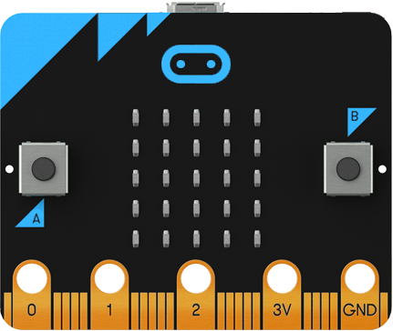
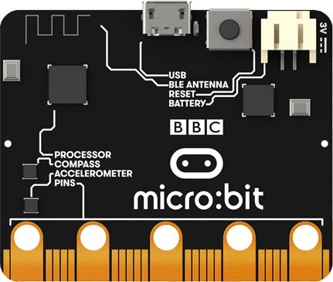
Micro:Bit
Without that timeline, this little device would not be possible
Microcircuitry contains high density electronics on a silicon wafer.
Board contains:
Sensors: Compass, Accelerometer, Temperature, Light
25 LEDs, 2 buttons and an edge connector
Connectivity: Bluetooth, Wifi Radio, USB

Slide 6
Paper Circuits
Conductive tape, ink or lead pencil lines on paper substrate.
Used with a processor combines art with electronics.
Designs can be printed at home and the circuit laid out in pencil, ink or tape.

Slide 7
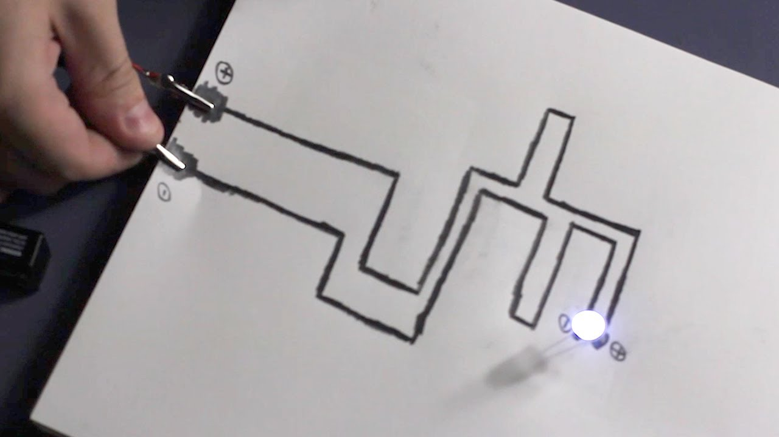
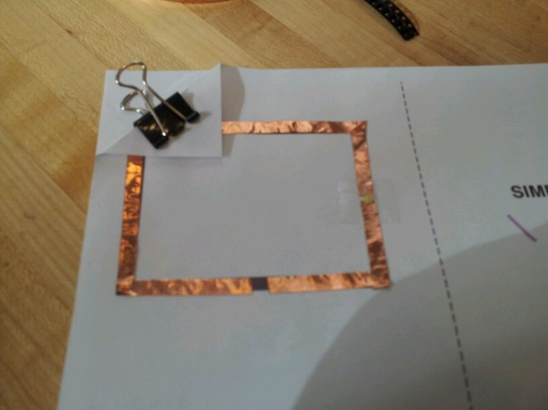
Sample Paper Circuits

Slide 8
Demo

Slide 9
Electronics Study List
Insulators
Conductors
Ohms Law
Kirchhoff's Laws
Magnetism
DC Current
AC Current
Reactance in AC
Transformers
Transistors (BJT, UJT, FET, MOSFET)
Amplifiers – Class A to Class G
Regulation and Power Supplies
Oscillators
Transceivers
Logical Gates
CPU’s
Synchros and Servo’s
Radars and microwaves
Systems

